Slide 1
Internal Model Control

Slide 2

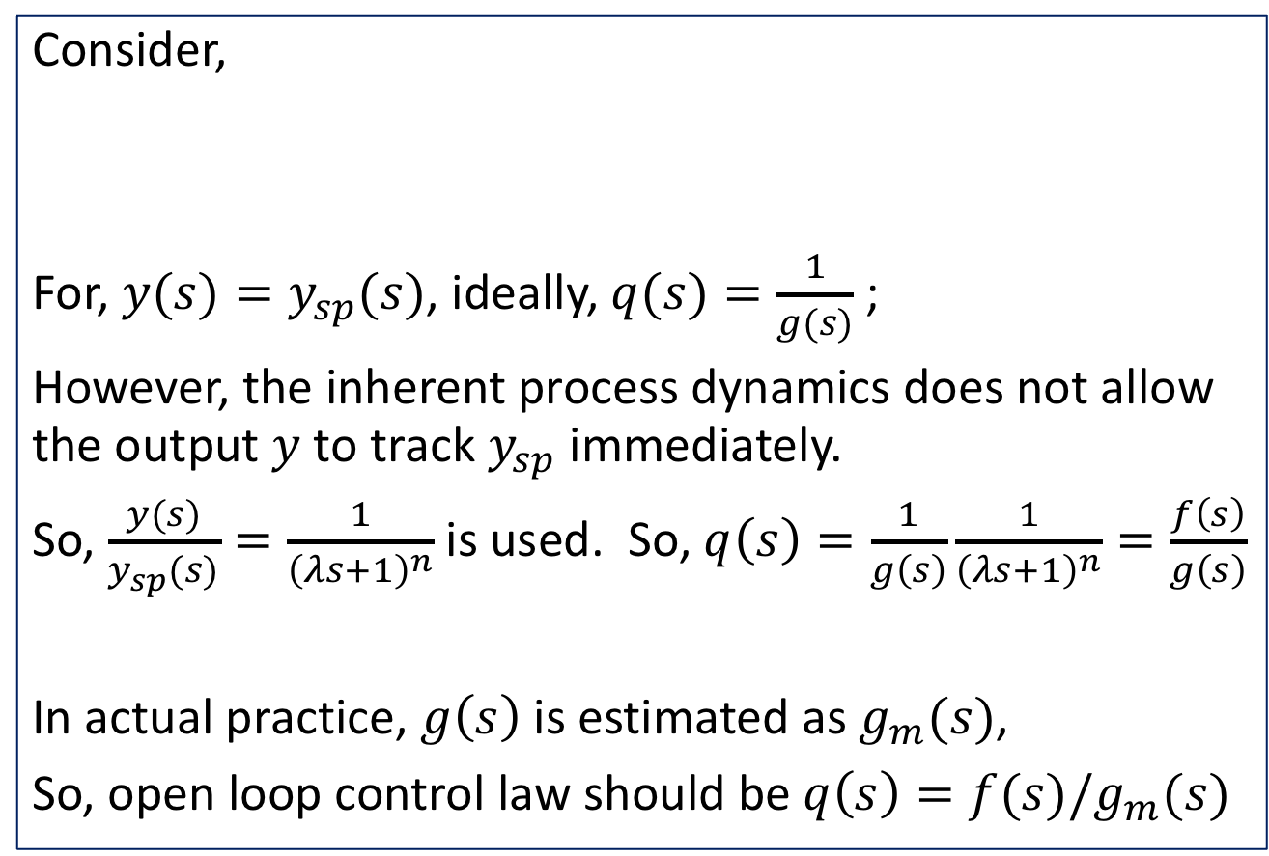



Open loop Control
Consider,
For, $y(s)=y_{sp}(s)$, ideally, $q(s)=\frac{1}{g(s)}$ ;
However, the inherent process dynamics does not allow the output $y$ to track $y_{sp}$ immediately.
So, $\frac{y(s)}{y_{sp}(s)}=\frac{1}{{\left(λs+1\right)}^{n}}$ is used. So, $q\left(s\right)=\frac{1}{g\left(s\right)}\frac{1}{{\left(λs+1\right)}^{n}}=\frac{f\left(s\right)}{g\left(s\right)}$
In actual practice, $g\left(s\right)$ is estimated as $g_{m}(s)$,
So, open loop control law should be $q\left(s\right)=f(s)/g_{m}(s)$
$$y_{sp}$$
$$q$$
$$g$$
$$y$$

Slide 3
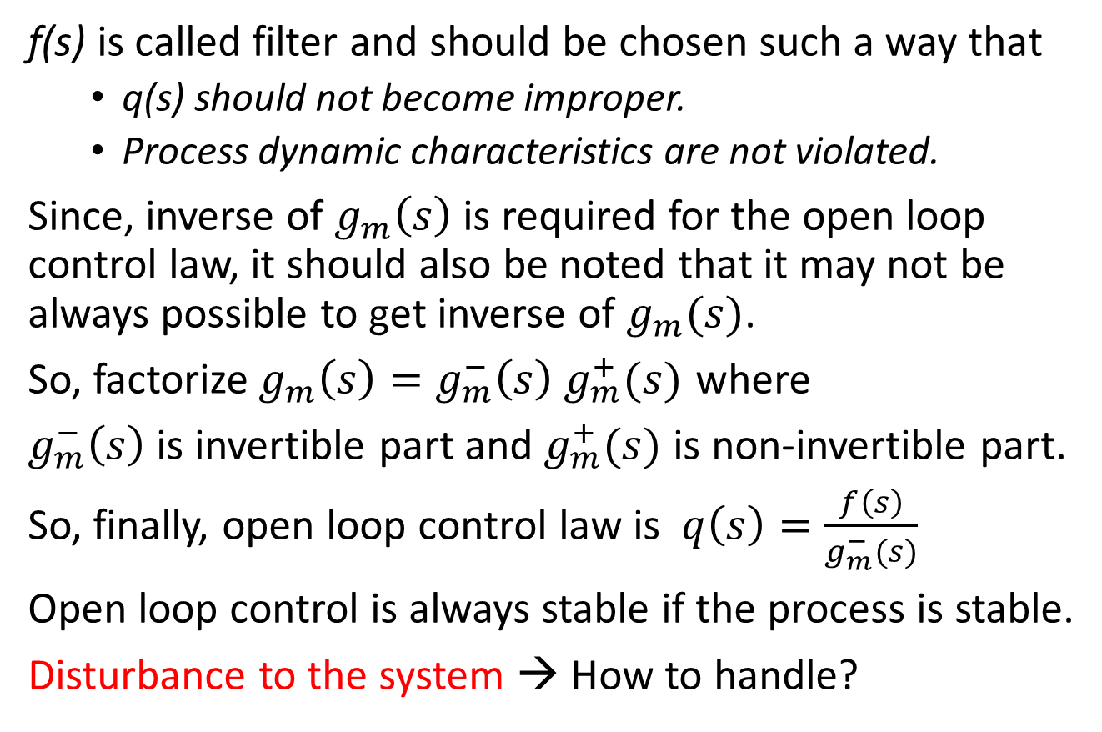
Open loop control
f(s) is called filter and should be chosen such a way that
q(s) should not become improper.
Process dynamic characteristics are not violated.
Since, inverse of $g_{m}\left(s\right)$ is required for the open loop control law, it should also be noted that it may not be always possible to get inverse of $g_{m}(s)$.
So, factorize$g_{m}\left(s\right)=g_{m}^{−}\left(s\right) g_{m}^{+}(s)$ where
$g_{m}^{−}\left(s\right)$ is invertible part and $g_{m}^{+}(s)$ is non-invertible part.
So, finally, open loop control law is $q\left(s\right)=\frac{f\left(s\right)}{g_{m}^{−}(s)}$
Open loop control is always stable if the process is stable.
Disturbance to the system → How to handle?

Slide 4








Internal Model Control
Open loop control law discussed earlier can not take care of disturbances to the process.
How to take care of disturbance?
Disturbance, d is estimated internally using a process model
The above is called Internal Model Control structure.
d
$$y_{sp}$$
$$y_{sp}$$
u
$$y$$
$$q$$
$$g$$
+
+
+
-
$$g_{m}$$
$$y_{m}$$
+
-
$$d_{m}=y−y_{m}$$

Slide 5
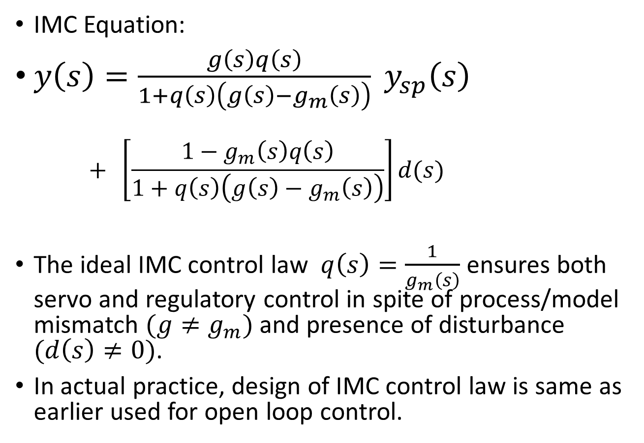
Internal Model Control
IMC Equation:
$y\left(s\right)=\frac{g\left(s\right)q\left(s\right)}{1+q\left(s\right)\left(g\left(s\right)−g_{m}\left(s\right)\right)} y_{sp}\left(s\right)$
$$+ \left[\frac{1−g_{m}\left(s\right)q\left(s\right)}{1+q\left(s\right)\left(g\left(s\right)−g_{m}\left(s\right)\right)}\right]d(s)$$
The ideal IMC control law $q\left(s\right)=\frac{1}{g_{m}\left(s\right)}$ ensures both servo and regulatory control in spite of process/model mismatch $(g≠g_{m})$ and presence of disturbance $(d\left(s\right)≠0)$.
In actual practice, design of IMC control law is same as earlier used for open loop control.

Slide 6
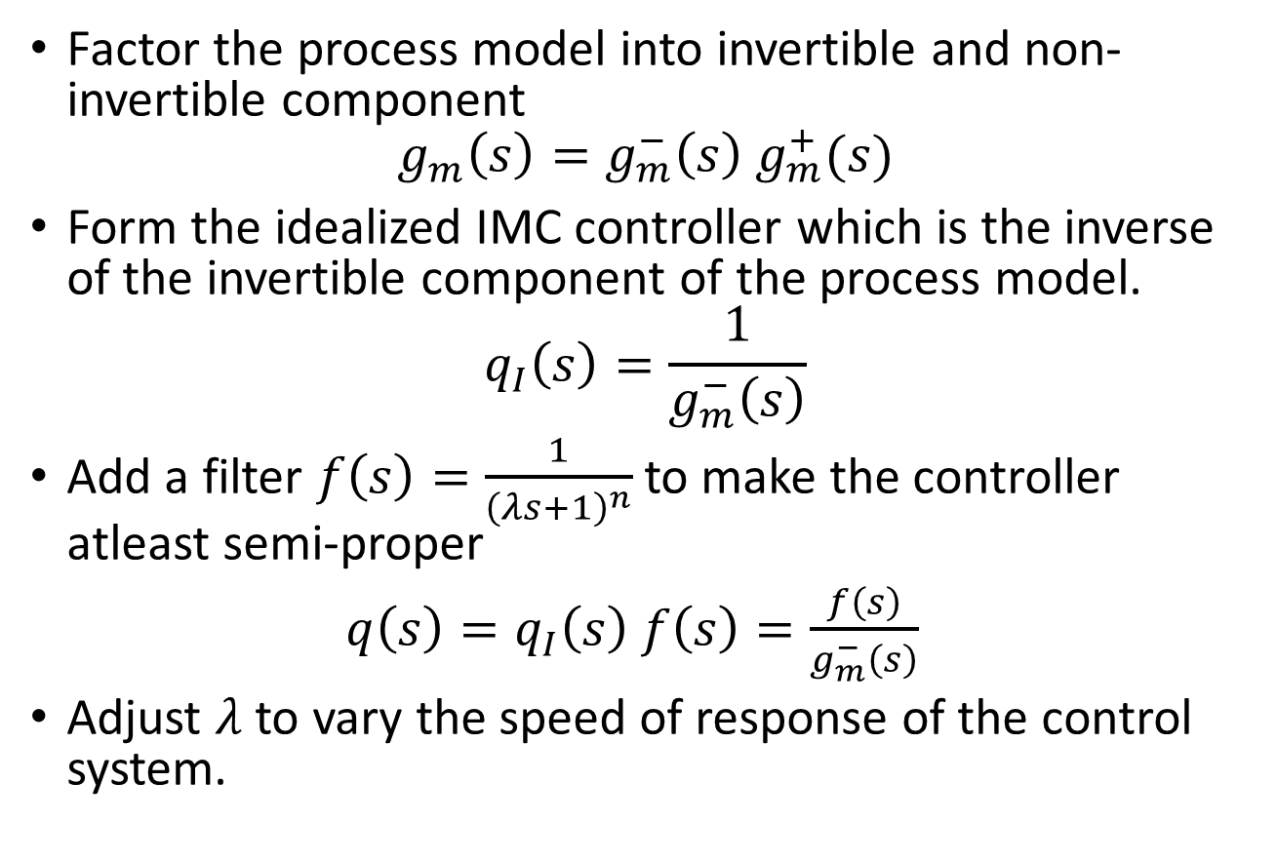
IMC Design Procedure
Factor the process model into invertible and non-invertible component
$$g_{m}\left(s\right)=g_{m}^{−}\left(s\right) g_{m}^{+}(s)$$
Form the idealized IMC controller which is the inverse of the invertible component of the process model.
$$q_{I}\left(s\right)=\frac{1}{g_{m}^{−}\left(s\right)}$$
Add a filter $f\left(s\right)=\frac{1}{{\left(λs+1\right)}^{n}}$ to make the controller atleast semi-proper
$q\left(s\right)=q_{I}\left(s\right) f\left(s\right)=\frac{f\left(s\right)}{g_{m}^{−}\left(s\right)}$
Adjust $λ$ to vary the speed of response of the control system.

Slide 7
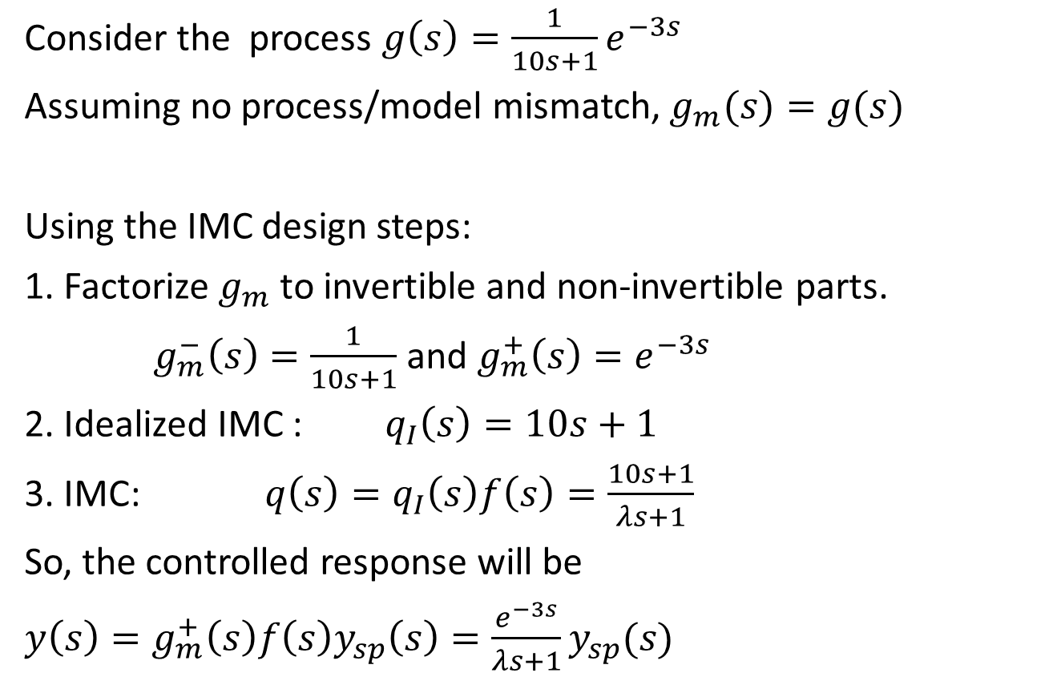
Example-1: FODT Process
Consider the process $g\left(s\right)=\frac{1}{10s+1}e^{−3s}$
Assuming no process/model mismatch, $g_{m}(s)=g(s)$
Using the IMC design steps:
1. Factorize $g_{m}$ to invertible and non-invertible parts.
$g_{m}^{−}\left(s\right)=\frac{1}{10s+1}$ and $g_{m}^{+}\left(s\right)=e^{−3s}$
2. Idealized IMC : $q_{I}\left(s\right)=10s+1$
3. IMC: $q\left(s\right)=q_{I}\left(s\right)f\left(s\right)=\frac{10s+1}{λs+1}$
So, the controlled response will be
$y\left(s\right)=g_{m}^{+}\left(s\right)f\left(s\right)y_{sp}\left(s\right)=\frac{e^{−3s}}{λs+1}y_{sp}(s)$

Slide 8
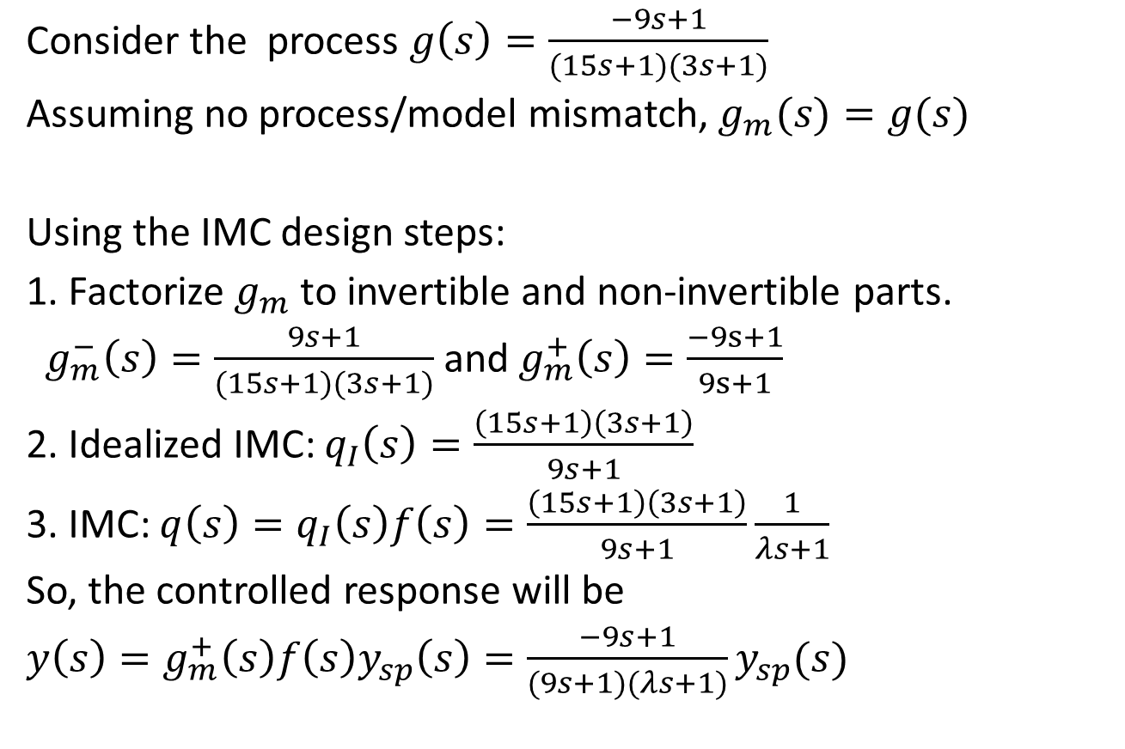
Example-2: SO with RHP zero
Consider the process $g\left(s\right)=\frac{−9s+1}{(15s+1)(3s+1)}$
Assuming no process/model mismatch, $g_{m}(s)=g(s)$
Using the IMC design steps:
1. Factorize $g_{m}$ to invertible and non-invertible parts.
$g_{m}^{−}\left(s\right)=\frac{9s+1}{(15s+1)(3s+1)}$ and $g_{m}^{+}\left(s\right)=\frac{−9s+1}{9s+1}$
2. Idealized IMC: $q_{I}\left(s\right)=\frac{\left(15s+1\right)\left(3s+1\right)}{9s+1}$
3. IMC: $q\left(s\right)=q_{I}\left(s\right)f\left(s\right)=\frac{\left(15s+1\right)\left(3s+1\right)}{9s+1}\frac{1}{λs+1}$
So, the controlled response will be
$y\left(s\right)=g_{m}^{+}\left(s\right)f\left(s\right)y_{sp}\left(s\right)=\frac{−9s+1}{(9s+1)(λs+1)}y_{sp}(s)$

Slide 9














IMC based PID Controller
d
$$y_{sp}$$
u
+
$$y$$
+
$$q$$
$$g$$
+
-
$$g_{m}$$
$$y_{m}$$
+
-
IMC structure
$$d_{m}=y−y_{m}$$
d
PID Controller $g_{c}$
$$y_{sp}$$
+
$$q$$
u
$$g$$
+
$$y$$
+
+
-
+
$$y_{m}$$
$$g_{m}$$
Feedback Structure

Slide 10
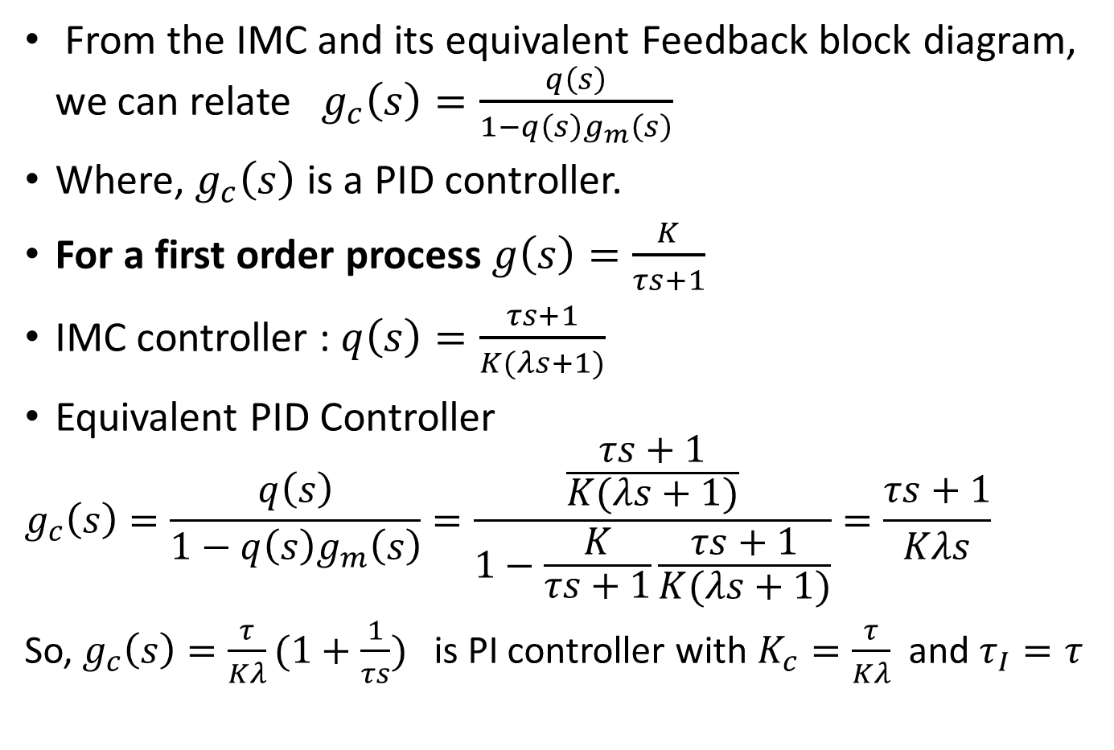
IMC based PID Controller design
From the IMC and its equivalent Feedback block diagram, we can relate $g_{c}\left(s\right)=\frac{q\left(s\right)}{1−q\left(s\right)g_{m}\left(s\right)}$
Where, $g_{c}\left(s\right)$ is a PID controller.
For a first order process $g\left(s\right)=\frac{K}{τs+1}$
IMC controller : $q\left(s\right)=\frac{τs+1}{K(λs+1)}$
Equivalent PID Controller
$$g_{c}\left(s\right)=\frac{q\left(s\right)}{1−q\left(s\right)g_{m}\left(s\right)}=\frac{\frac{τs+1}{K(λs+1)}}{1−\frac{K}{τs+1}\frac{τs+1}{K(λs+1)}}=\frac{τs+1}{Kλs}$$
So, $g_{c}\left(s\right)=\frac{τ}{Kλ}(1+\frac{1}{τs})$ is PI controller with $K_{c}=\frac{τ}{Kλ}$ and $τ_{I}=τ$

Slide 11
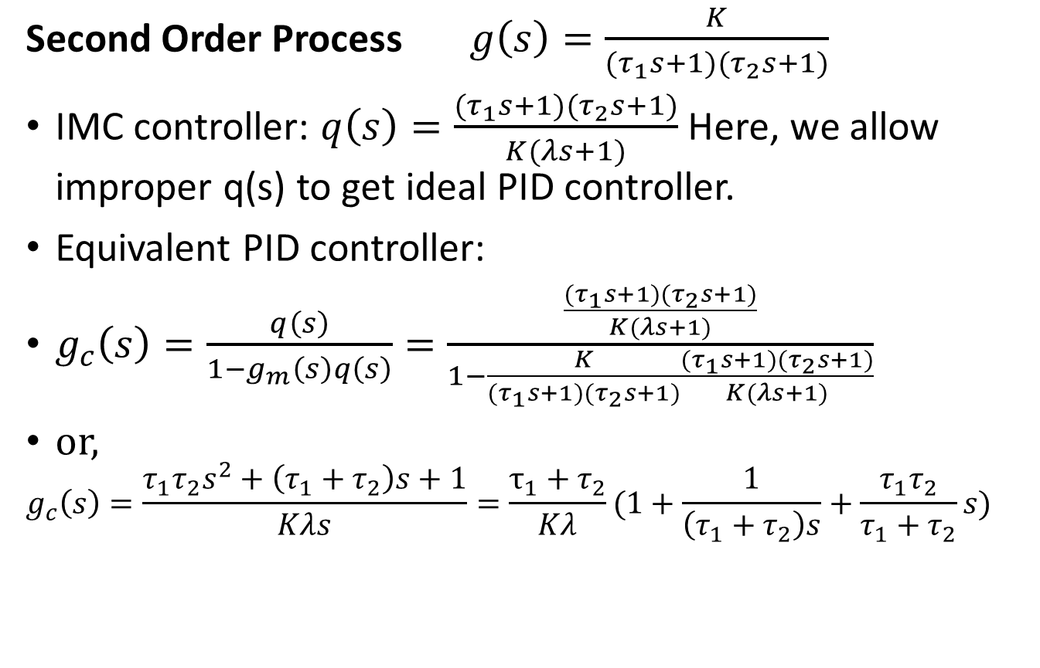
IMC based PID Controller Design
Second Order Process $g\left(s\right)=\frac{K}{{(τ}_{1}s+1)(τ_{2}s+1)}$
IMC controller: $q\left(s\right)=\frac{{(τ}_{1}s+1)(τ_{2}s+1)}{K(λs+1)}$ Here, we allow improper q(s) to get ideal PID controller.
Equivalent PID controller:
$g_{c}\left(s\right)=\frac{q\left(s\right)}{1−g_{m}\left(s\right)q\left(s\right)}=\frac{\frac{{(τ}_{1}s+1)(τ_{2}s+1)}{K(λs+1)}}{1−\frac{K}{{(τ}_{1}s+1)(τ_{2}s+1)}\frac{{(τ}_{1}s+1)(τ_{2}s+1)}{K(λs+1)}}$
or,
$$g_{c}\left(s\right)=\frac{τ_{1}τ_{2}s^{2}+\left(τ_{1}+τ_{2}\right)s+1}{Kλs}=\frac{τ_{1}+τ_{2}}{Kλ}(1+\frac{1}{\left(τ_{1}+τ_{2}\right)s}+\frac{τ_{1}τ_{2}}{τ_{1}+τ_{2}}s)$$

Slide 12
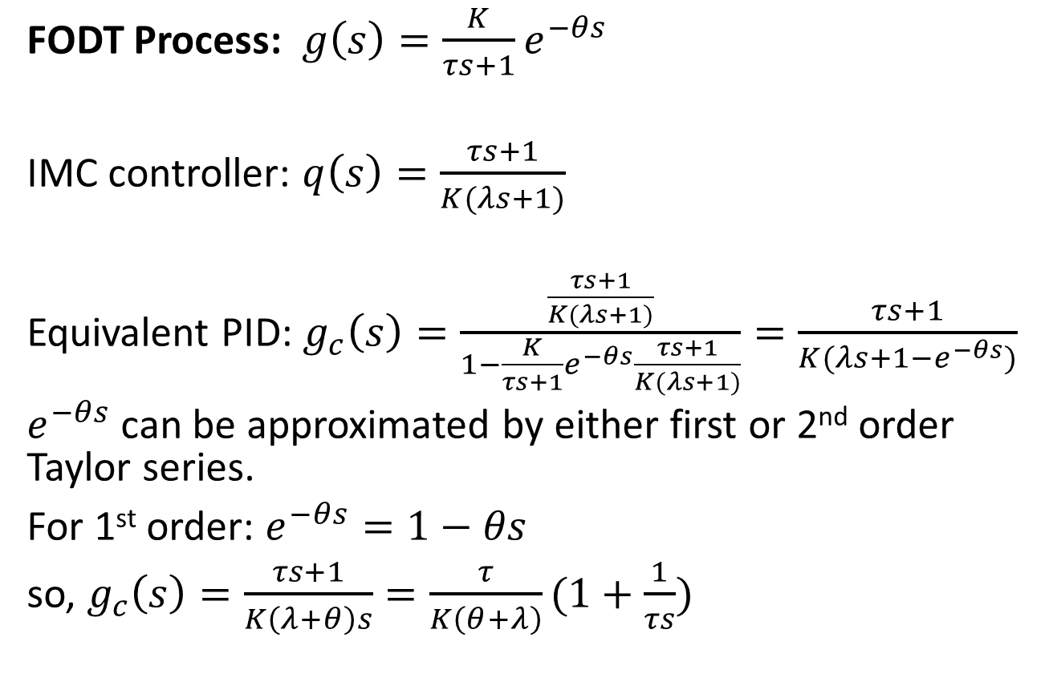
IMC based PID Controller Design
FODT Process: $g\left(s\right)=\frac{K}{τs+1}e^{−θs}$
IMC controller: $q\left(s\right)=\frac{τs+1}{K(λs+1)}$
Equivalent PID: $g_{c}\left(s\right)=\frac{\frac{τs+1}{K(λs+1)}}{1−\frac{K}{τs+1}e^{−θs}\frac{τs+1}{K(λs+1)}}=\frac{τs+1}{K(λs+1−e^{−θs})}$
$e^{−θs}$ can be approximated by either first or 2nd order Taylor series.
For 1st order: $e^{−θs}=1−θs$
so, $g_{c}\left(s\right)=\frac{τs+1}{K\left(λ+θ\right)s}=\frac{τ}{K\left(θ+λ\right)}(1+\frac{1}{τs})$

Slide 13
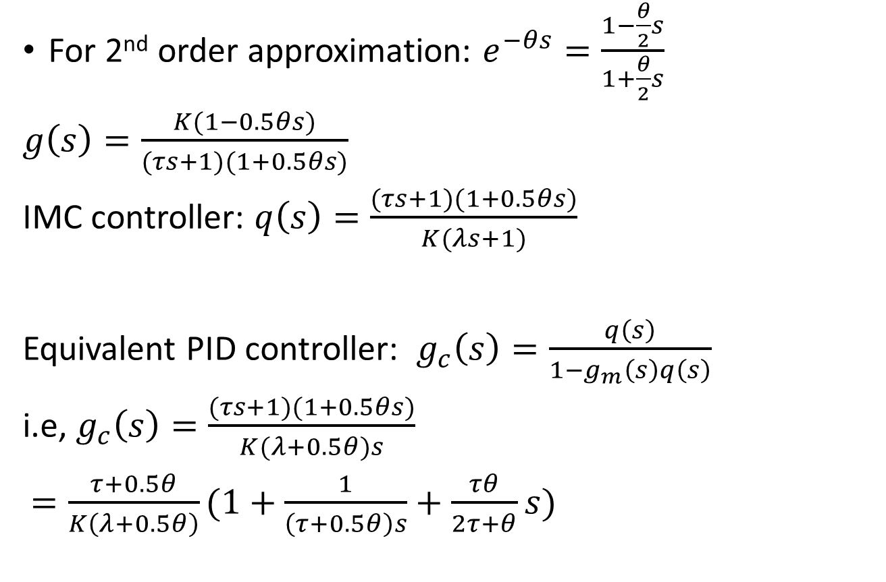
IMC based PID Controller Design
For 2nd order approximation: $e^{−θs}=\frac{1−\frac{θ}{2}s}{1+\frac{θ}{2}s}$
$g\left(s\right)=\frac{K(1−0.5θs)}{(τs+1)(1+0.5θs)}$
IMC controller: $q\left(s\right)=\frac{(τs+1)(1+0.5θs)}{K(λs+1)}$
Equivalent PID controller: $g_{c}\left(s\right)=\frac{q\left(s\right)}{1−g_{m}\left(s\right)q\left(s\right)}$
i.e, $g_{c}\left(s\right)=\frac{(τs+1)(1+0.5θs)}{K(λ+0.5θ)s}$
$=\frac{τ+0.5θ}{K\left(λ+0.5θ\right)}(1+\frac{1}{\left(τ+0.5θ\right)s}+\frac{τθ}{2τ+θ}s)$

Slide 14
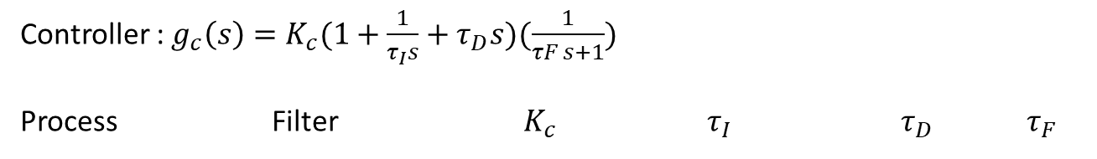
IMC based PID Controller Design
Controller : $g_{c}\left(s\right)=K_{c}(1+\frac{1}{τ_{I}s}+τ_{D}s)(\frac{1}{τF s+1})$
Process Filter $K_{c}$ $τ_{I}$ $τ_{D}$ $τ_{F}$

Slide 15
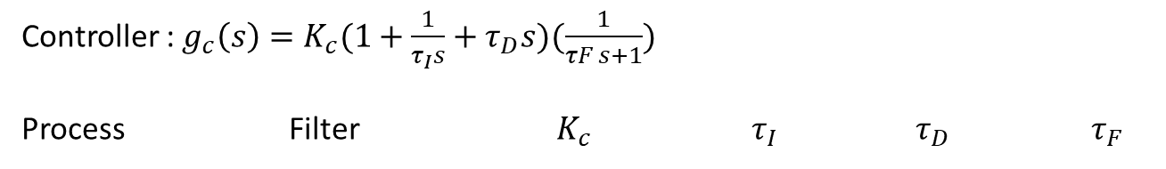
IMC based PID Controller Design
Controller : $g_{c}\left(s\right)=K_{c}(1+\frac{1}{τ_{I}s}+τ_{D}s)(\frac{1}{τF s+1})$
Process Filter $K_{c}$ $τ_{I}$ $τ_{D}$ $τ_{F}$

Slide 16
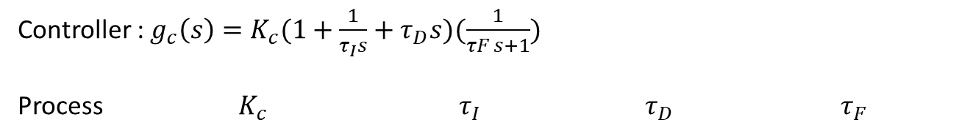
Controller : $g_{c}\left(s\right)=K_{c}(1+\frac{1}{τ_{I}s}+τ_{D}s)(\frac{1}{τF s+1})$
Process $K_{c}$ $τ_{I}$ $τ_{D}$ $τ_{F}$

Slide 17
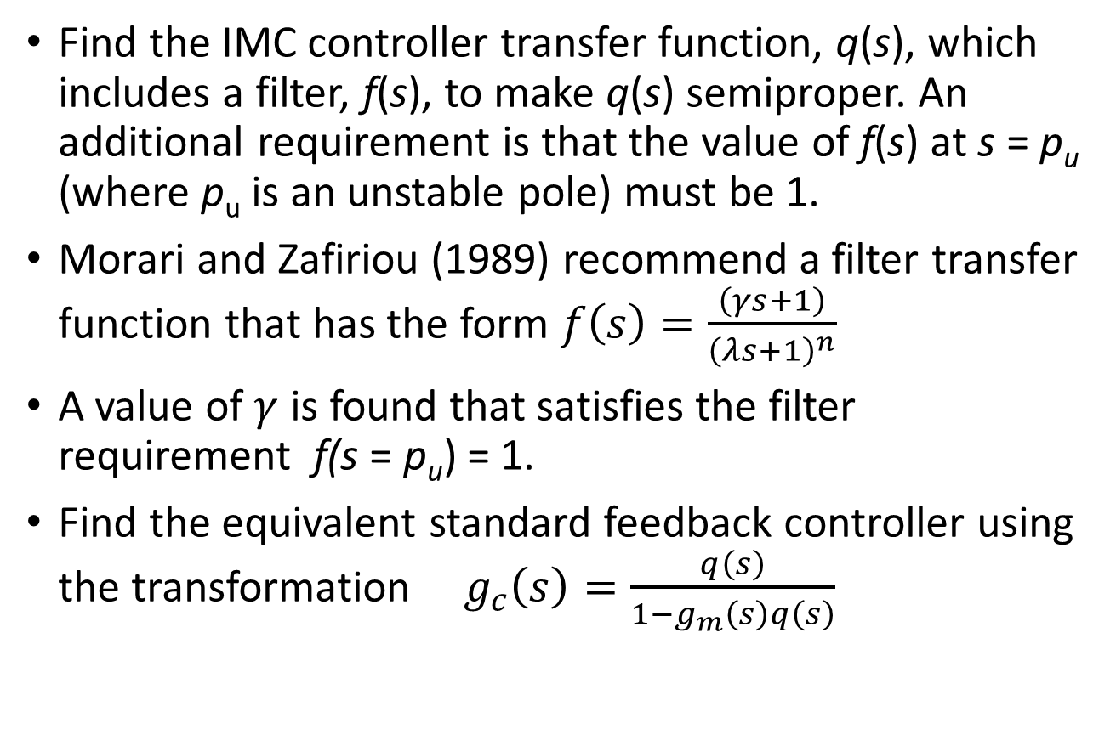
IMC based PID for unstable process
Find the IMC controller transfer function, q(s), which includes a filter, f(s), to make q(s) semiproper. An additional requirement is that the value of f(s) at s = p_{u} (where p_{u} is an unstable pole) must be 1.
Morari and Zafiriou (1989) recommend a filter transfer function that has the form $f\left(s\right)=\frac{\left(γs+1\right)}{{\left(λs+1\right)}^{n}}$
A value of $γ$ is found that satisfies the filter requirement f(s = p_{u}) = 1.
Find the equivalent standard feedback controller using the transformation ${ g}_{c}\left(s\right)=\frac{q\left(s\right)}{1−g_{m}\left(s\right)q\left(s\right)}$

Slide 18
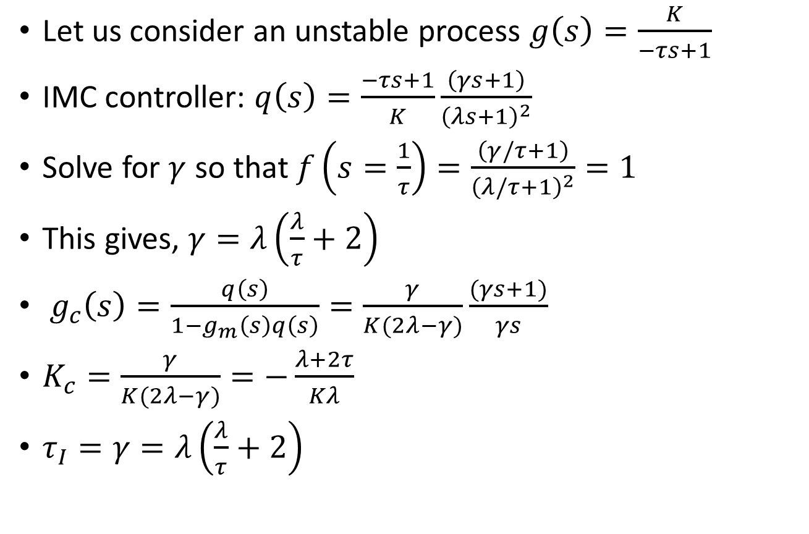
Example
Let us consider an unstable process $g\left(s\right)=\frac{K}{−τs+1}$
IMC controller: $q\left(s\right)=\frac{−τs+1}{K}\frac{\left(γs+1\right)}{{\left(λs+1\right)}^{2}}$
Solve for $γ$ so that $f\left(s=\frac{1}{τ}\right)=\frac{\left(γ/τ+1\right)}{{\left(λ/τ+1\right)}^{2}}=1$
This gives, $γ=λ\left(\frac{λ}{τ}+2\right)$
${ g}_{c}\left(s\right)=\frac{q\left(s\right)}{1−g_{m}\left(s\right)q\left(s\right)}=\frac{γ}{K(2λ−γ)}\frac{(γs+1)}{γs}$
$K_{c}=\frac{γ}{K(2λ−γ)}=−\frac{λ+2τ}{Kλ}$
$τ_{I}=γ=λ\left(\frac{λ}{τ}+2\right)$

Slide 19
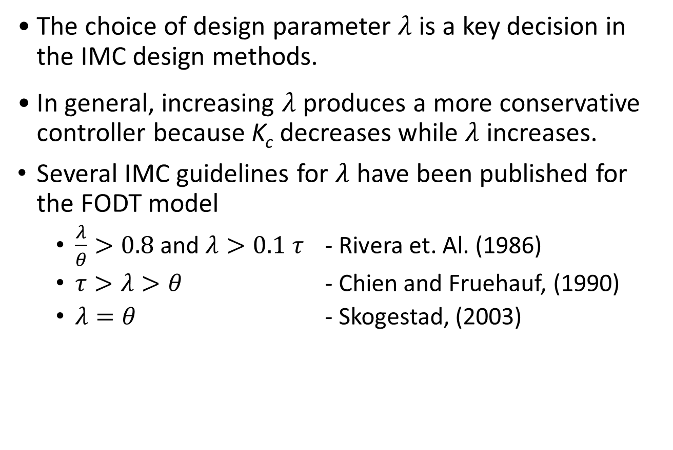

Selection of $λ$
The choice of design parameter $λ$ is a key decision in the IMC design methods.
In general, increasing $λ$ produces a more conservative controller because K_{c} decreases while $λ$ increases.
Several IMC guidelines for $λ$ have been published for the FODT model
$\frac{λ}{θ}>0.8$ and $λ>0.1 τ$ - Rivera et. Al. (1986)
$τ>λ>θ$ - Chien and Fruehauf, (1990)
$λ=θ$ - Skogestad, (2003)

Slide 20
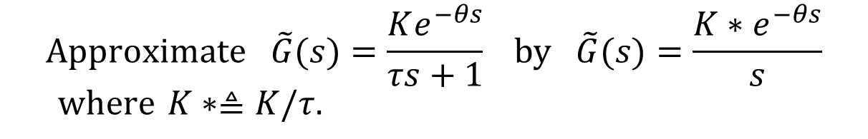

Tuning for Lag-Dominant Models
First- or second-order models with relatively small time delays are referred to as lag-dominant models.
The IMC and DS methods provide satisfactory set-point responses, but very slow disturbance responses, because the value of is very large.
Fortunately, this problem can be solved in three different ways.
Method 1: Integrator Approximation
$$\left(θ/τ≪1\right)$$
$$\text{Approximate} \tilde{G}(s)=\frac{Ke^{−θs}}{τs+1} \text{by} \tilde{G}(s)=\frac{K∗e^{−θs}}{s} \\ \text{where} K∗≜K/τ.$$
Then use the IMC tuning rules to specify the controller settings.

Slide 21
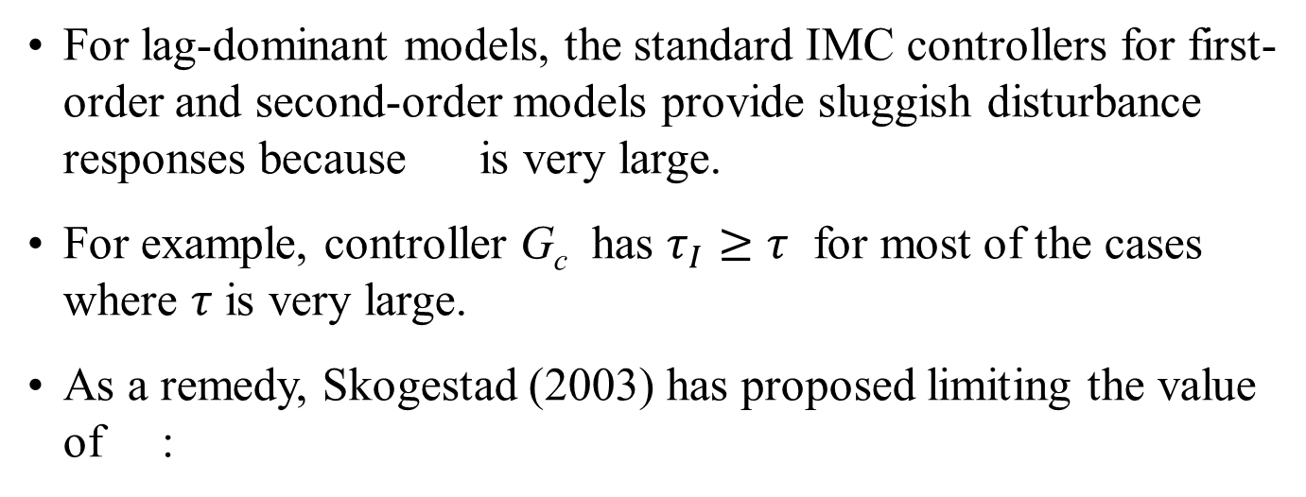
Method 2. Limit the Value of τ_{I}
For lag-dominant models, the standard IMC controllers for first-order and second-order models provide sluggish disturbance responses because is very large.
For example, controller G_{c} has $τ_{I}≥τ$ for most of the cases where $τ$ is very large.
As a remedy, Skogestad (2003) has proposed limiting the value of :
where τ₁ is the largest time constant (if there are two).
Method 3. Design the Controller for Disturbances, Rather
Set-point Changes
The desired CLTF is expressed in terms of (Y/D)_{des}, rather than (Y/Y_{sp})_{des}
Reference: Chen & Seborg (2002)

Slide 22
Example
Consider a lag-dominant model with
Design four PI controllers:
IMC
IMC based on the integrator approximation
IMC with Skogestad’s modification
Direct Synthesis method for disturbance rejection (Chen and Seborg, 2002): The controller settings are K_{c} = 0.551 and

Slide 23
Evaluate the four controllers by comparing their performance for unit step changes in both set point and disturbance. Assume that the model is perfect and that G_{d}(s) = G(s).
Solution
The PI controller settings are:
Controller | K_{c}
IMC | 0.5 | 100
(b) Integrator approximation | 0.556 | 5
(c) Skogestad | 0.5 | 8
(d) DS-d | 0.551 | 4.91

Slide 24
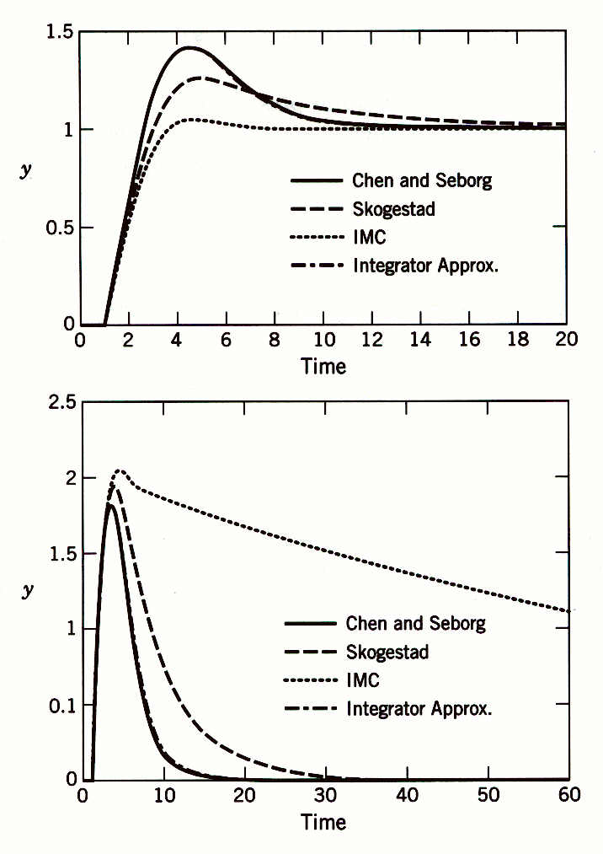
Comparison of set-point responses (top) and disturbance responses (bottom). The responses for the Chen and Seborg and integrator approximation methods are essentially identical.

Slide 25
Time Delay Processes
Dead times, or time delays, are found in many processes in industry.
Dead times are mainly caused by the
accumulation of time lags in a number of dynamic systems connected in series (e.g. distillation column)
Transportation lag (long pipelines)
Slow measuring device: GC
Sampling delays introduced by computer control
For processes exhibiting dead time, every action executed in the manipulated variable of the process will only affect the controlled variable after the process dead time.

Slide 26
Effect of Time Delay
Processes with large dead time are difficult to control by pure feedback control (PID) alone because
Effect of disturbances is not seen by controller for a while
Effect of control action is not seen at the output for a while. This causes controller to take additional compensation unnecessary.
This results in unnecessary oscillation and loss of feedback loop controllability.
Dead times produce a decrease in the system phase and also give rise to a non-rational transfer function of the system, making them more difficult to analyse and control.

Slide 27
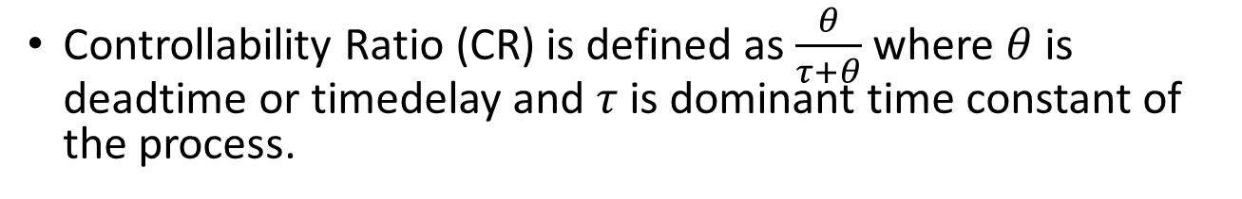
Controllability Ratio
Controllability Ratio (CR) is defined as $\frac{θ}{τ+θ}$ where $θ$ is deadtime or timedelay and $τ$ is dominant time constant of the process.
CR =1 represents pure delay processes. As CR increases, the stability of the control loop decreases. PID controller has to be tuned with lower gain (Z-N tuning) resulting sluggish response.

Slide 28
Effect of Controllability Ratio
Robustness of the controller decreases.
Both Gain Margin and Phase Margin reduced

Slide 29
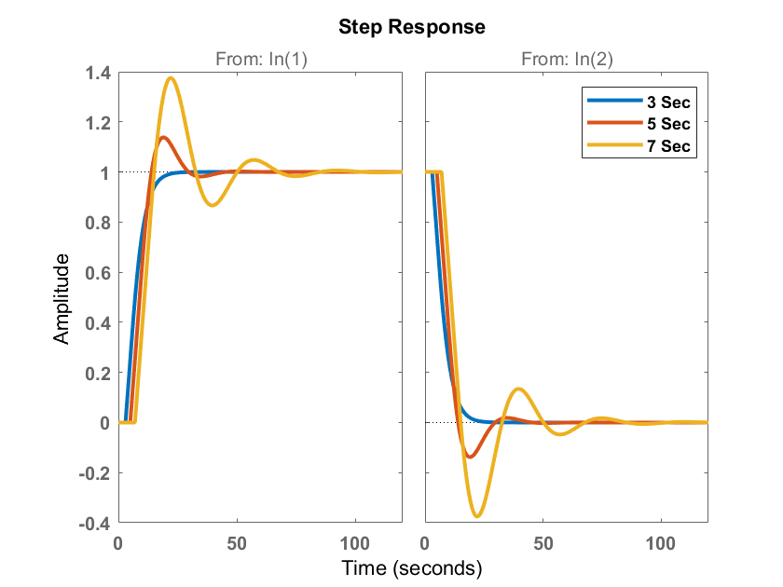
Effect of Deadtime on output response

Slide 30

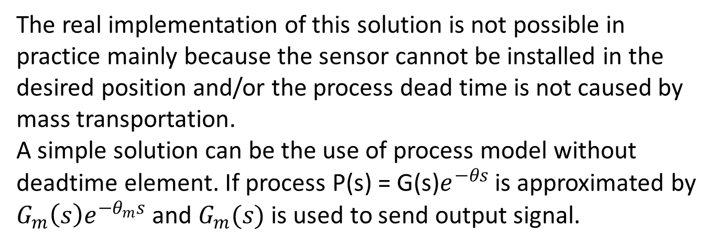


Predictor based solution
Ideal solution is to send the undelayed output signal to the controller as shown in the figure.
$$y_{sp}$$
$$y$$
C(s)
$$e^{−θs}$$
+
C(s)
G(s)
-
The real implementation of this solution is not possible in practice mainly because the sensor cannot be installed in the desired position and/or the process dead time is not caused by mass transportation.
A simple solution can be the use of process model without deadtime element. If process P(s) = G(s)$e^{−θs}$ is approximated by $G_{m}\left(s\right)e^{−θ_{m}s}$ and $G_{m}(s)$ is used to send output signal.

Slide 31


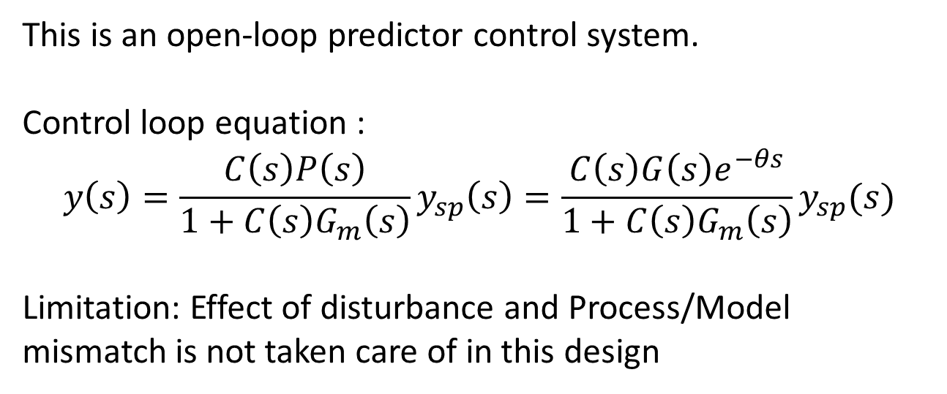
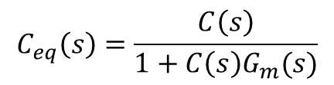

Predictor based solution
$$y_{sp}$$
$$y$$
C(s)
P(s)
+
C(s)
-
$${\overline{y}}_{m}(s)$$
G_{m}(s)
$$C_{eq}\left(s\right)=\frac{C\left(s\right)}{1+C\left(s\right)G_{m}(s)}$$
This is an open-loop predictor control system.
Control loop equation :
$$y\left(s\right)=\frac{C\left(s\right)P\left(s\right)}{1+C\left(s\right)G_{m}\left(s\right)}y_{sp}\left(s\right)=\frac{C\left(s\right)G\left(s\right)e^{−θs}}{1+C\left(s\right)G_{m}\left(s\right)}y_{sp}(s)$$
Limitation: Effect of disturbance and Process/Model mismatch is not taken care of in this design

Slide 32



Smith Predictor
d(s)
$$y_{sp}$$
$$y$$
C(s)
P(s)
+
C(s)
-
+
G_{m}(s)
$$e^{−θ_{m}s}$$
-
$${\overline{y}}_{m}(s)$$
+
e_{p}(s)
+
With this structure, if there are no modelling errors or disturbances, the error between the current process output and the model output (e_{p}(t)) will be null and the controller can be tuned as if the plant had no dead time.
Thus, in the nominal case this structure gives the same performance as the ideal solution i.e, open loop predictor.
This structure was developed by Smith (1950) and is called Smith Predictor.

Slide 33






Smith Predictor : Feedback Structure
d(s)
$y_{sp}$(s)
$y$(s)
C(s)
P(s)
+
C(s)
-
+
$${G_{m}\left(s\right)(1−e}^{−θ_{m}s})$$
+
d(s)
$y_{sp}$(s)
$y$(s)
C(s)
P(s)
+
+
+
-
C(s)
+
-
$${G_{m}\left(s\right)(1−e}^{−θ_{m}s})$$

Slide 34
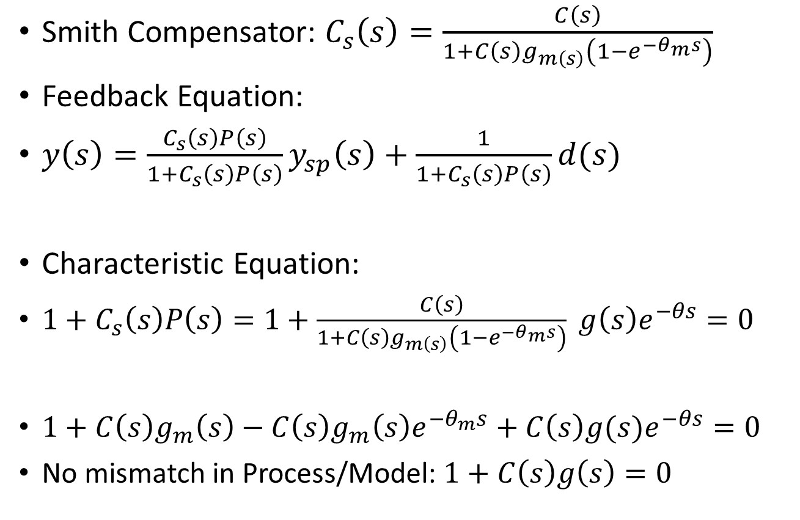
Characteristic Equation
Smith Compensator: $C_{s}\left(s\right)=\frac{C\left(s\right)}{1+C\left(s\right)g_{m\left(s\right)}\left(1−e^{−θ_{m}s}\right)}$
Feedback Equation:
$y\left(s\right)=\frac{C_{s}\left(s\right)P\left(s\right)}{1+C_{s}\left(s\right)P\left(s\right)}y_{sp}\left(s\right)+\frac{1}{1+C_{s}\left(s\right)P\left(s\right)}d(s)$
Characteristic Equation:
$1+C_{s}\left(s\right)P\left(s\right)=1+\frac{C\left(s\right)}{1+C\left(s\right)g_{m\left(s\right)}\left(1−e^{−θ_{m}s}\right)} g\left(s\right)e^{−θs}=0$
$1+C\left(s\right)g_{m}\left(s\right)−C\left(s\right)g_{m}\left(s\right)e^{−θ_{m}s}+C\left(s\right)g(s)e^{−θs}=0$
No mismatch in Process/Model: $1+C\left(s\right)g\left(s\right)=0$

Slide 35
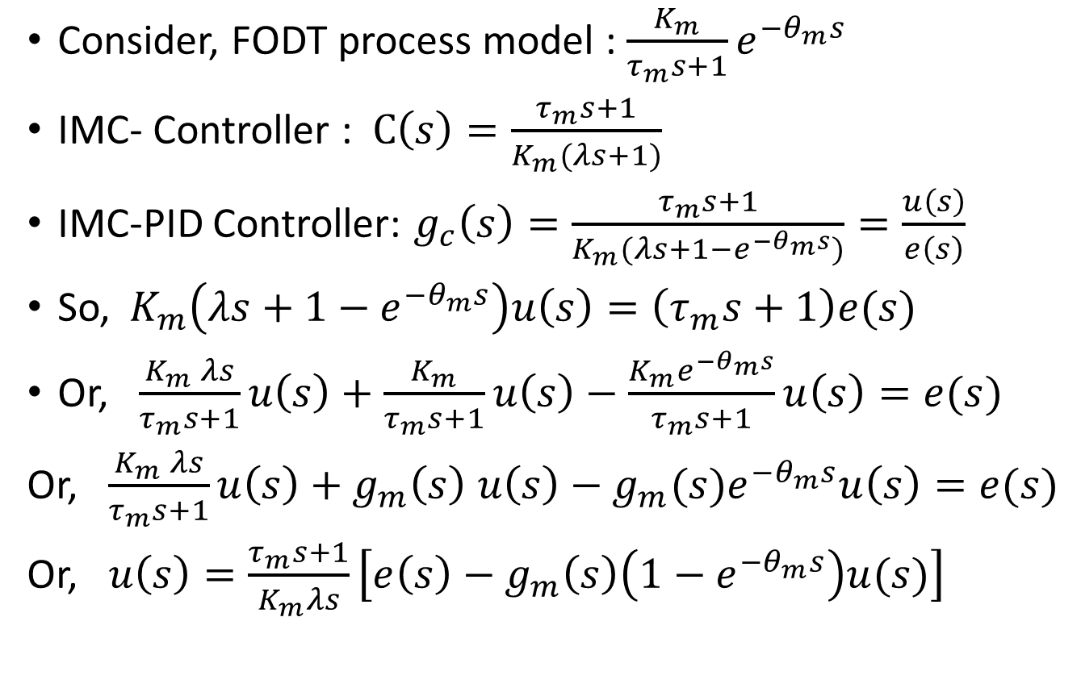
Smith compensator in IMC-PID
Consider, FODT process model : $\frac{K_{m}}{τ_{m}s+1}e^{−θ_{m}s}$
IMC- Controller : $C\left(s\right)=\frac{τ_{m}s+1}{K_{m}(λs+1)}$
IMC-PID Controller: $g_{c}\left(s\right)=\frac{τ_{m}s+1}{K_{m}(λs+1−e^{−θ_{m}s})}=\frac{u\left(s\right)}{e\left(s\right)}$
So,${ K}_{m}\left(λs+1−e^{−θ_{m}s}\right)u\left(s\right)=\left(τ_{m}s+1\right)e(s)$
Or, $\frac{K_{m} λs}{τ_{m}s+1}u\left(s\right)+\frac{K_{m}}{τ_{m}s+1}u\left(s\right)−\frac{K_{m}e^{−θ_{m}s}}{τ_{m}s+1}u\left(s\right)=e(s)$
Or, $\frac{K_{m} λs}{τ_{m}s+1}u\left(s\right)+g_{m}\left(s\right) u\left(s\right)−g_{m}(s)e^{−θ_{m}s}u\left(s\right)=e(s)$
Or, $u\left(s\right)=\frac{τ_{m}s+1}{K_{m}λs}\left[e\left(s\right)−g_{m}\left(s\right)\left(1−e^{−θ_{m}s}\right)u(s)\right]$

Slide 36
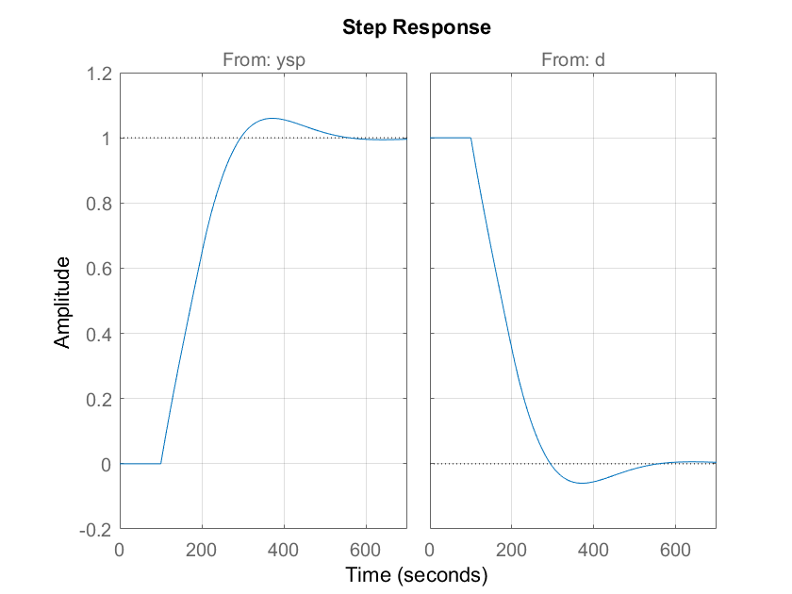

Matlab Implementation
Process: $P\left(s\right)=\frac{6}{43s+1}e^{−100s}$ and $g\left(s\right)=P(s)$
Feedback control of Process:
s=tf(‘s’);
P=6/(43*s+1)*exp(-100*s);
P.InputName=‘u’;
P.OutputName=‘y0’;
[C,info]=pidtune(P,pidstd(1,1));
Info
Pcl=feedback([P*C,1],1,1,1);
Pcl.InputName={‘ysp’, ‘d’};
step(Pcl), grid on;
Bandwidth : 0.0059 rad/s
Phase Margin : 60 degree

Slide 37
Matlab Implementation
% Prediction model
Gp = 6/(45*s+1); Gp.InputName = 'u'; Gp.OutputName = 'yp';
Dp = exp(-100*s); Dp.InputName = 'yp'; Dp.OutputName = 'y1';
% Develop Process with Smith Predictor
S1 = sumblk('dy = y0 - y1'); S2 = sumblk('ym = yp + dy');
Plant = connect(P,Gp,Dp,S1,S2,'u','ym');
% Design PI controller with 60 degrees phase margin
[C,info] = pidtune(Plant,pidstd(1,1)); C.InputName = 'e';C.OutputName = 'u';
% Assemble closed-loop model from [y_sp,d] to y
Sum1 = sumblk('e = ysp - yp - dy'); Sum2 = sumblk('y = y0 + d'); Sum3 = sumblk('dy = y - y1');
T = connect(P,Gp,Dp,C,Sum1,Sum2,Sum3,{'ysp','d'},'y');
% Design PI controller with 85 degrees phase margin
Opt = pidtuneOptions('PhaseMargin',85);
[C1,info] = pidtune(Plant,pidstd(1,1),Opt);
C1.InputName = 'e'; C1.OutputName = 'u';
T1 = connect(P,Gp,Dp,C1,Sum1,Sum2,Sum3,{'ysp','d'},'y');
% Use STEP to compare the Smith Predictor (blue) with the PI controller (red):
step(T1,'b',T,'b--',gcl,'r--'), grid on

Slide 38
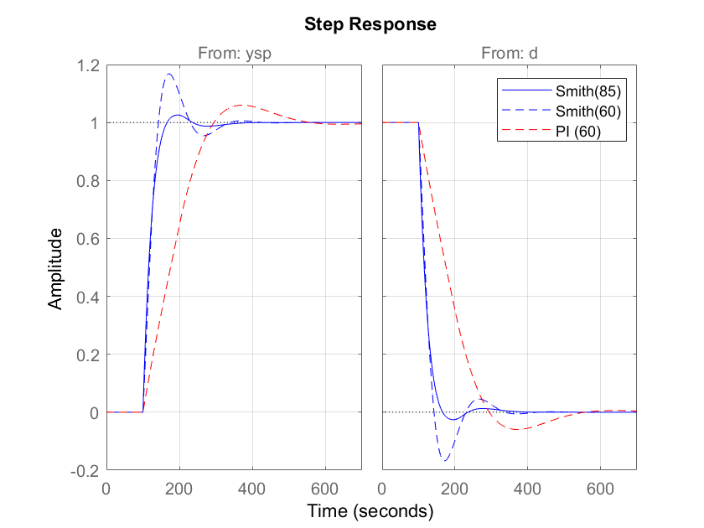
Matlab Implementation

